Slide 1
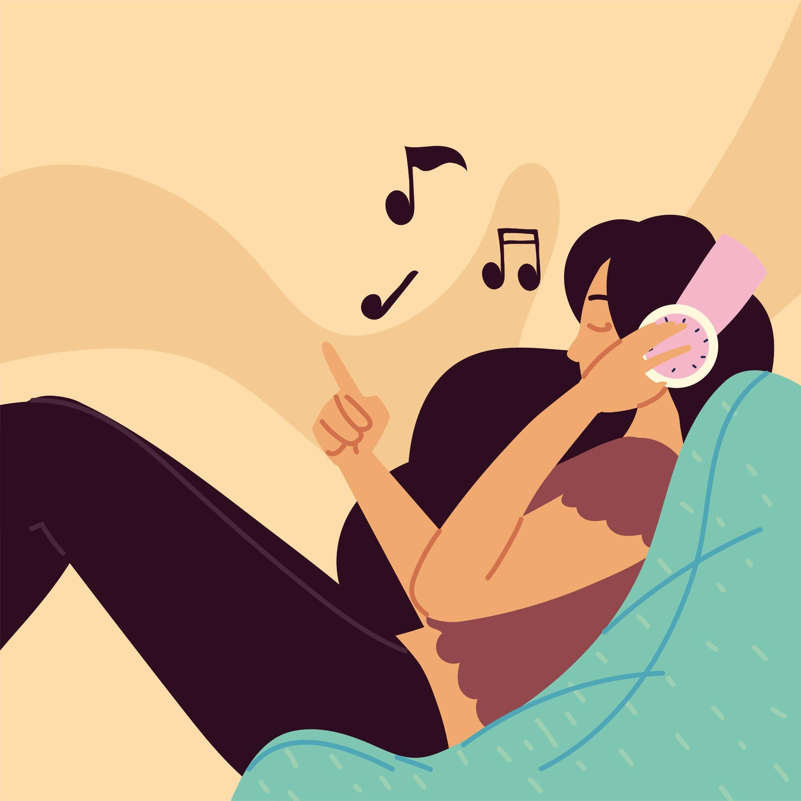
Music and Our Emotions
Team 112 -
Aidan E.
Arielle R.
Milena P.
Sean A.

Slide 2
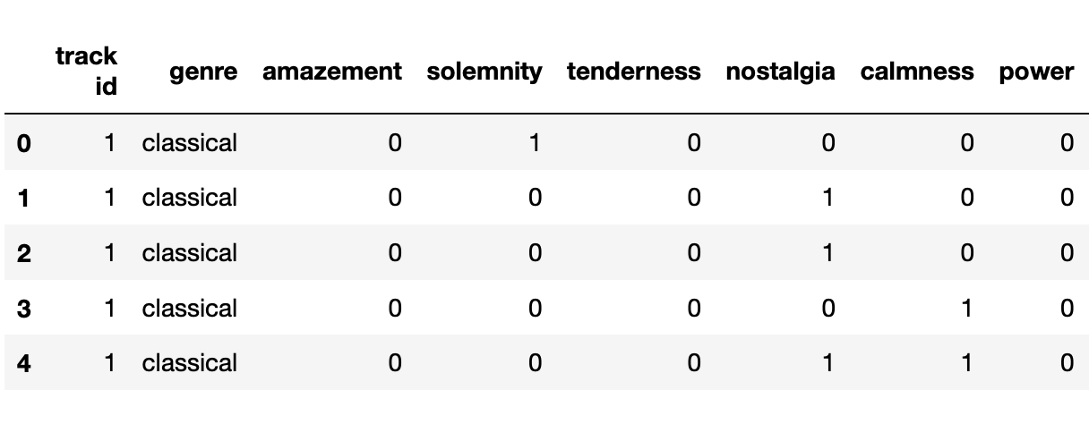
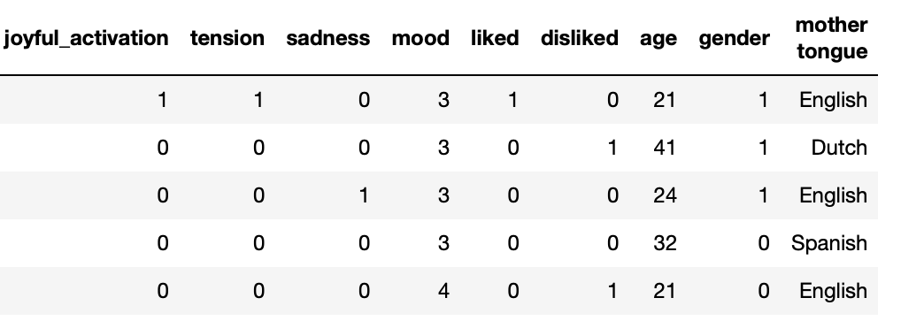
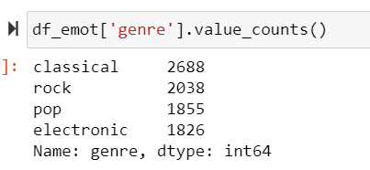
Data Description
8407 entries:
400 songs
personal information
Mood prior listening to the song
9 emotions (self-reported)
1-felt
0-not felt

Slide 3
Motivation:
Music tends to be grouped in pre-existing genres like pop, rock, electronic, and classical.
Through this project, we’d like to find out these genres can be predicted based off user’s emotions and personal data. We’d also like to find out if there are more natural groupings of music based off of a listener’s emotions rather than the predefined genres we know.

Slide 4
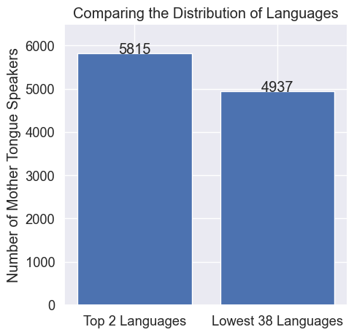
Ethical Considerations
Bias
Uneven distribution of Mother Tongue’s
English: 3309 Speakers
Urdu: 2 Speakers
Only four genres are represented

Slide 5
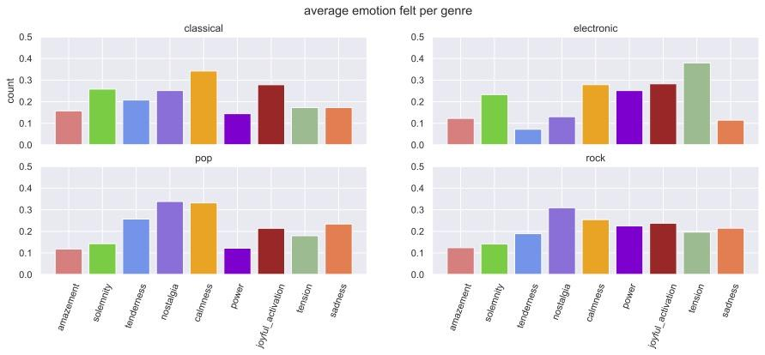
Notes:
Rock doesn’t have as distinct emotions felt as classical or electronic.

Slide 6
Machine Learning Methods
Classification:
Can the genre be predicted based off emotions and user data?
Decision Tree Classifier
Random Forest Classifier
KNN Classifier
K-Means Clustering:
Can songs be put into new clusters based off emotions instead of their predefined genres?

Slide 7
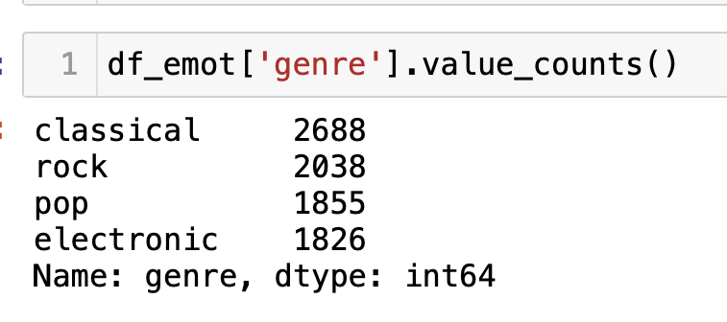
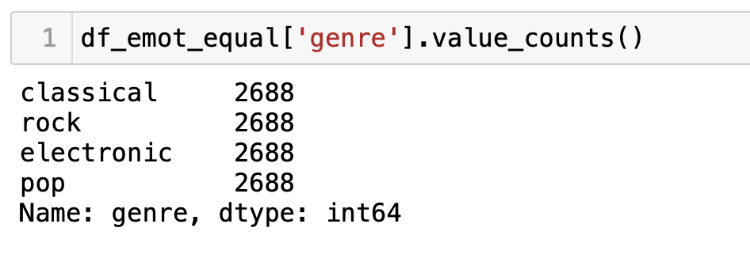
Classification: Managing Data
Bootstrapping:

Slide 8
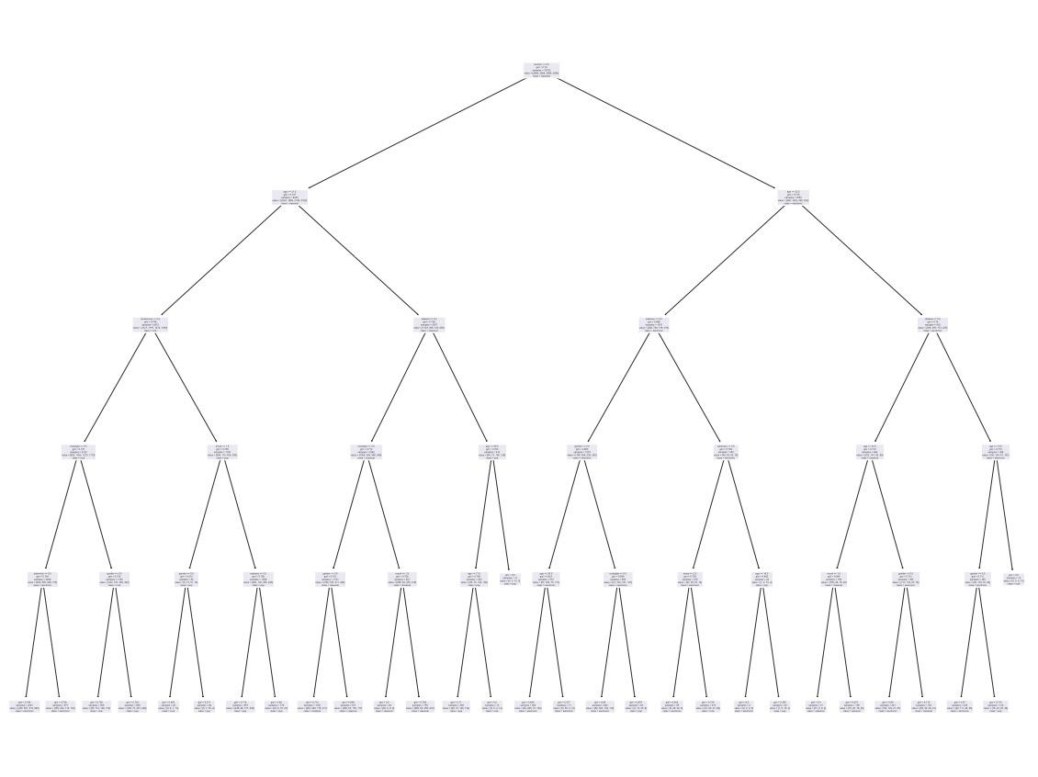
Decision Tree Classifier
Max-depth = 5

Slide 9
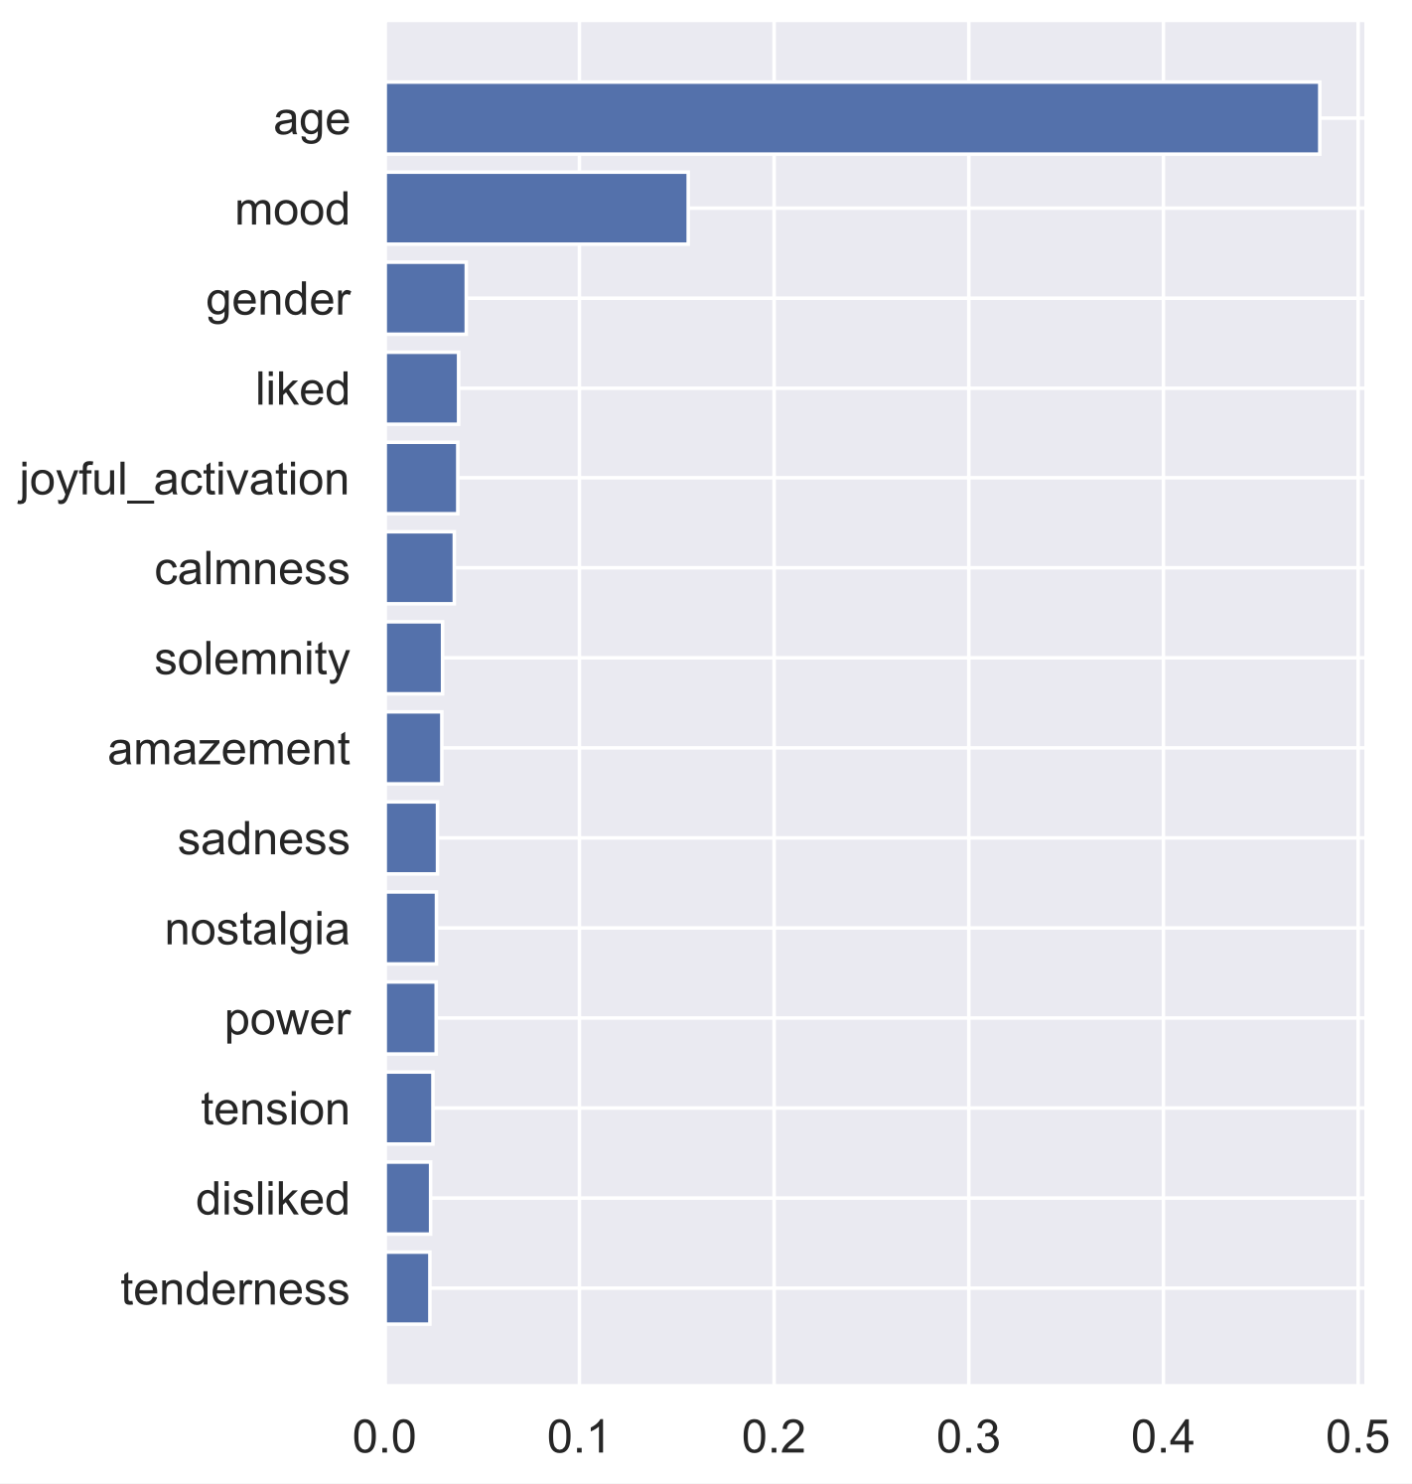
Random Forest Classifier:
Feature Importance

Slide 10
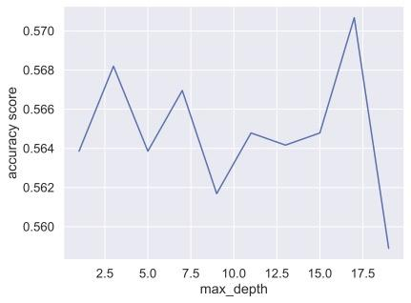
Random Forest Classifier:
Optimizing Max Depth

Slide 11
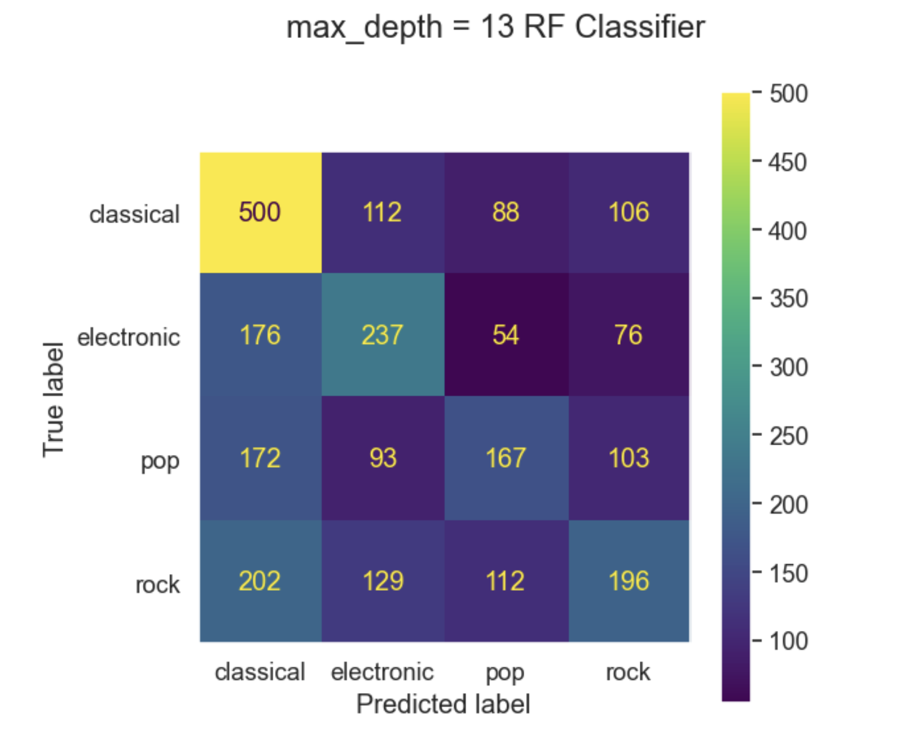
Random Forest Classifier:
Confusion Matrix
without bootstrapping:
43.24%
with bootstrapping:
57.22%
with cross validation:
58.75%

Slide 12
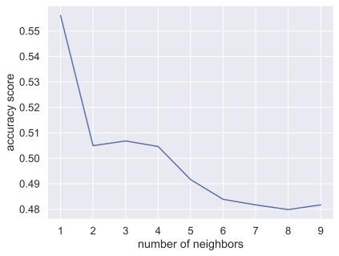
KNN Classifier:
K optimization

Slide 13
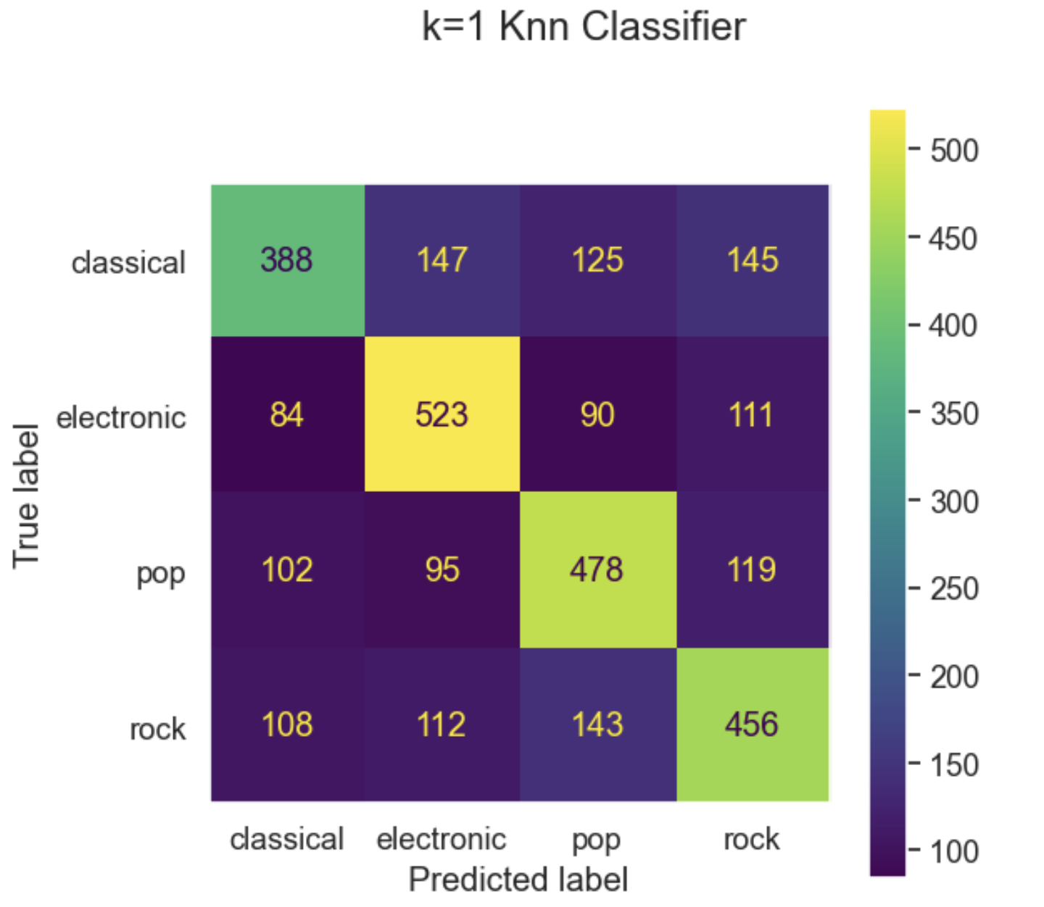
KNN Classifier:
Confusion Matrix
Accuracy Score:
57.15%

Slide 14
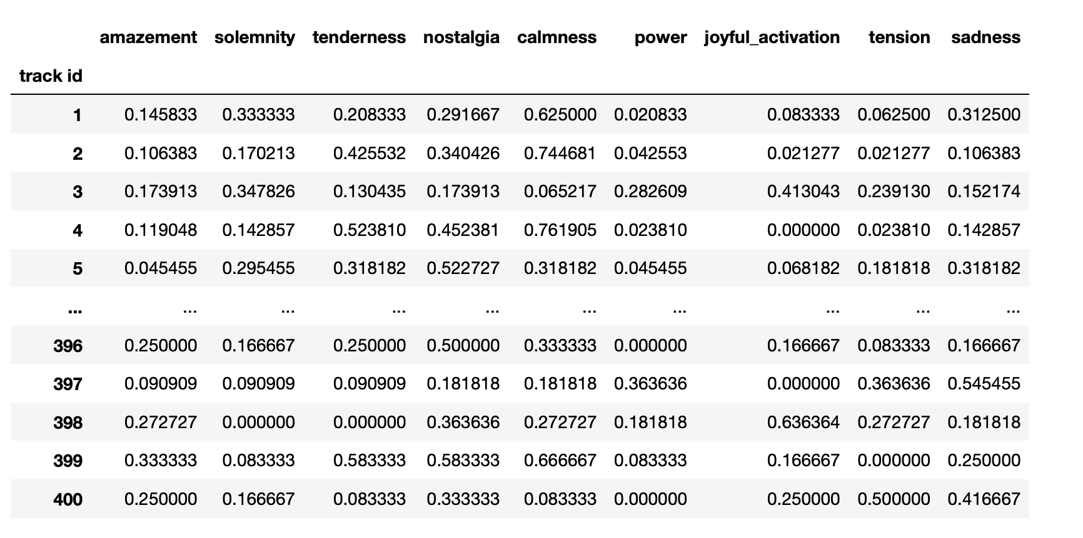
K-Means Clustering:
Managing Data
Group by track id: average emotion per song
400 songs

Slide 15
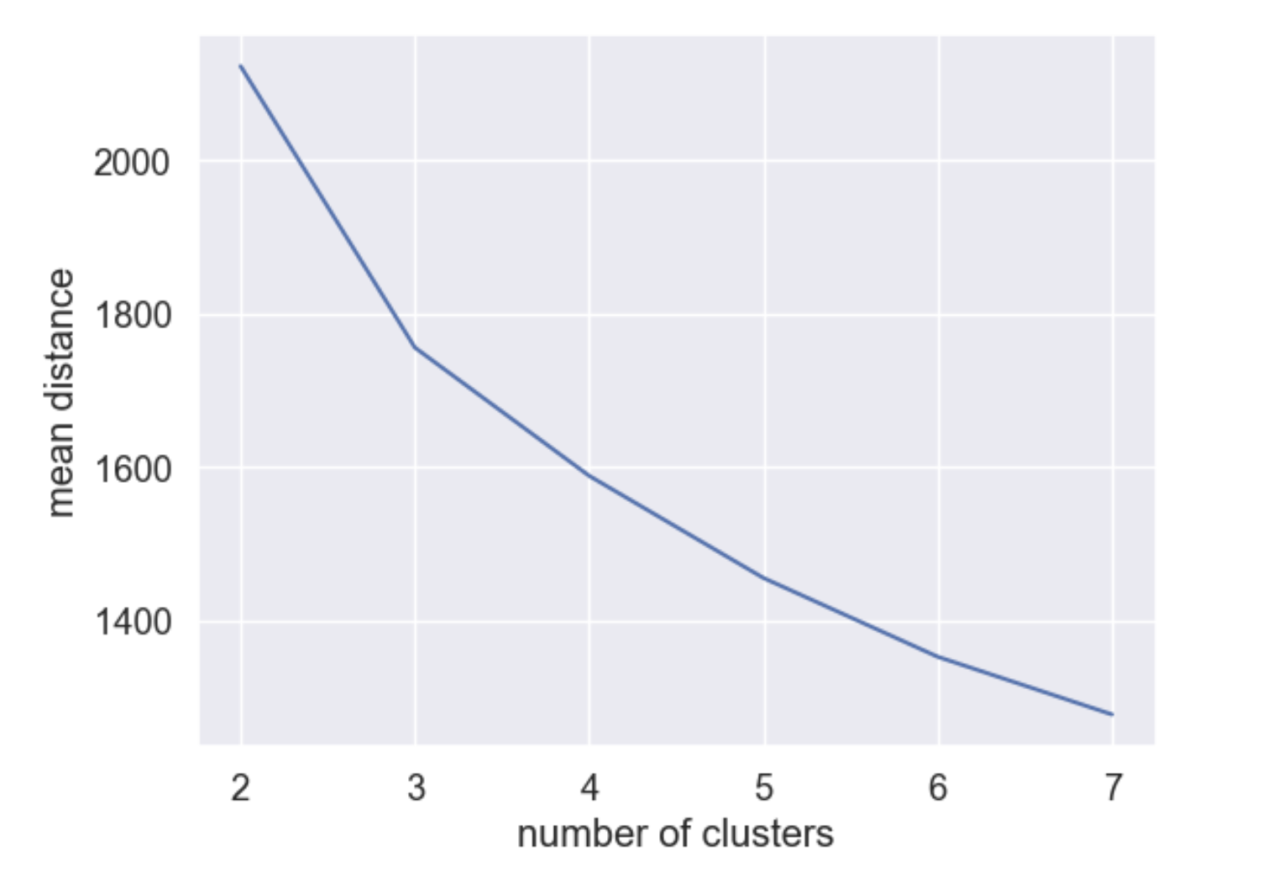
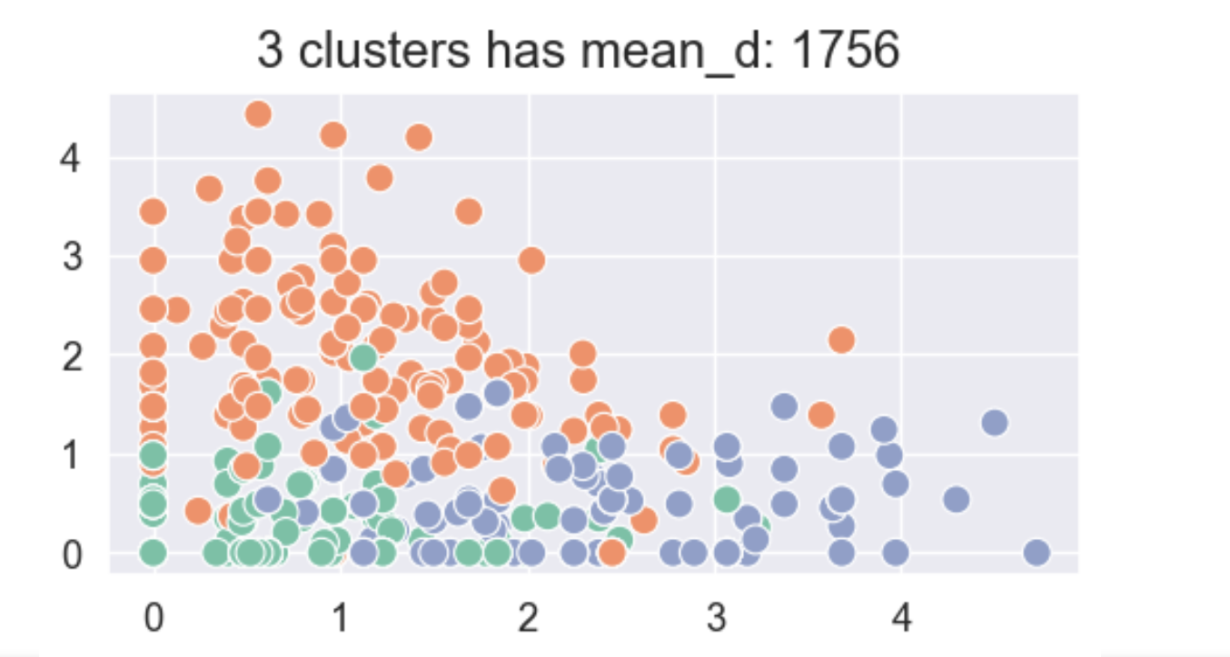
K-Means Clustering

Slide 16

What Worked:
What Didn’t:
Next Time:
Bootstrapping
Dataset:
non-linear
categorical information
no listener ID
Music is personal and subjective - emotions are not uniform in a single genre - emotions cannot be assumed for an entire genre
keep track of listener ID
Redefine tracks into 3 clusters, predict which cluster a listen belongs to–not genre

Slide 17
Thank You

